Slide 1
































PYEXPO25
Genius innovation leaves behind a legacy...
Team ID Team Name PS Number PS Title
: T080
: TECH TRAILBLAZERS
: PY036
: SMART POLICING USING AI AND FACIAL RECOGNITION
: COMPUTER VISION
: SOFTWARE
Domain Category
PYEXPO 2025
IPS TECH COMMUNITY

Slide 2


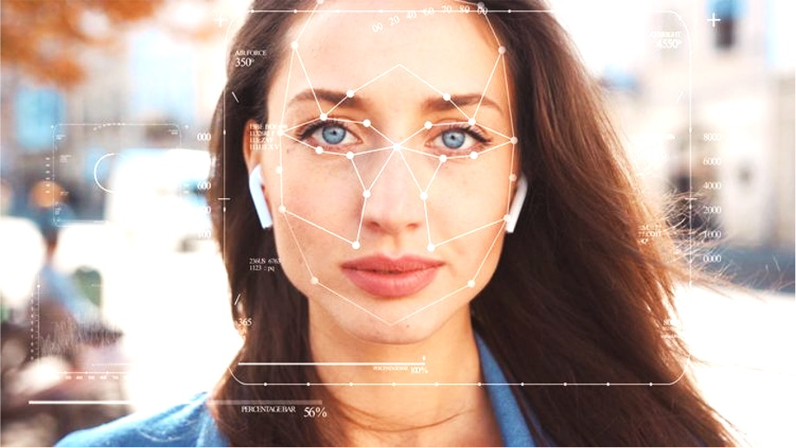
Problem Statement:
Our Smart Policing System utilizes facial recognition and AI by :
Implementing Real-Time Identification of a suspect
Reducing Human Errors
Lowering time consumption
Improving Crime Prevention
TARGET AUDIENCE:
Smart Policing System is designed to serve a wide range of clients including national security, law enforcement, border patrol, and immigration checks, etc…
PYEXPO 2025
IPS TECH COMMUNITY

Slide 3










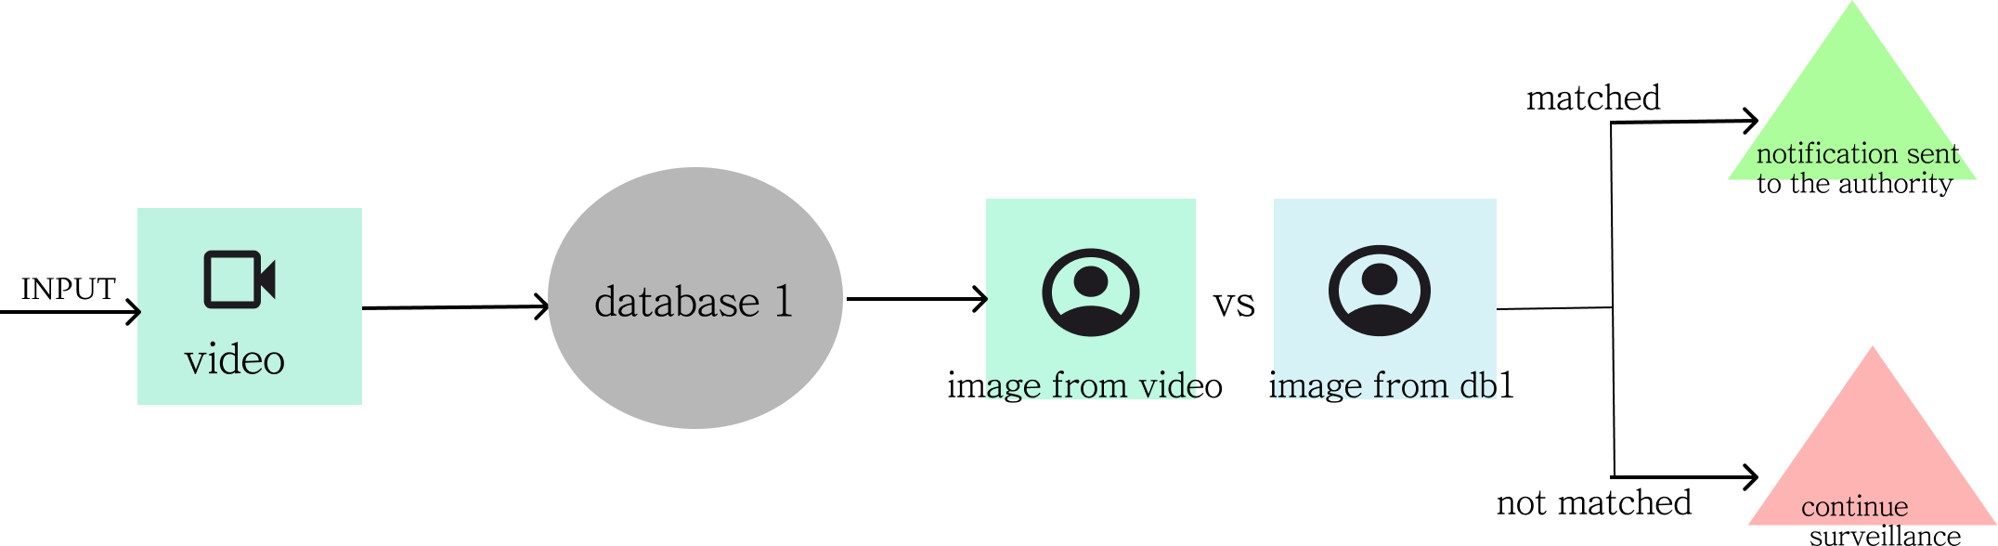
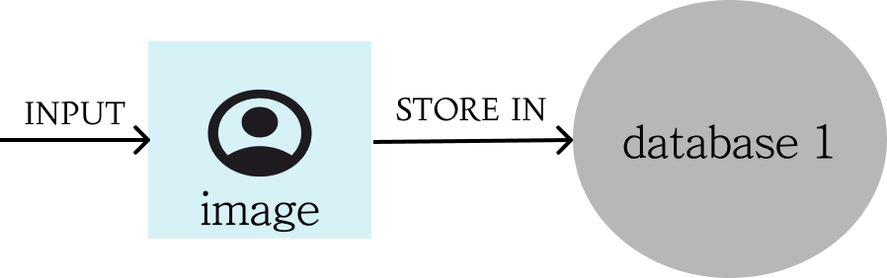



Proposed Solution and overview:
AI/ML SOLUTION:
This system automates decision making using facial recognition.
It enhances the efficiency of agencies by enabling real-time facial recognition of suspects.
By combining facial recognition and Intelligent Surveillance, we can predict criminals by monitoring their presence in an
area.
AI/ML MODEL APPROACH:
To acquire accurate matching facial recognition, the Smart Policing System uses FaceNet, a deep learning model built using TensorFlow and Yolo developed by Ultralytics.
Criminal data storage
PYEXPO 2025
IPS TECH COMMUNITY

Slide 4













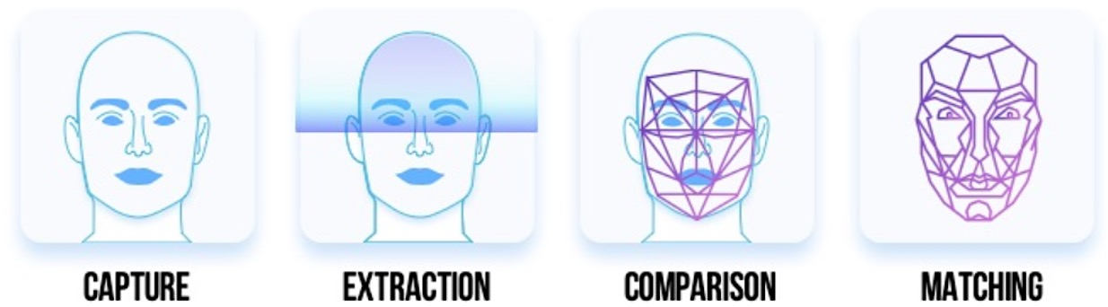
















Data And Model :
DATA SOURCES:
Smart Policing System uses government and law enforcement databases, such as criminal records and watchlists.
MODEL:
Preprocessing:
FaceNet projects the facial images into a 128-dimensional embedding space using a Convolutional Neural Network (CNN), allowing to extract and align faces. Yolo v8 has image resizing, normalization, augmentation, conversion to tensor.
Training Methods:
Uses Triplet Loss to learn embeddings by decreasing intra-class distance and increasing inter-class distance.
Yolo v8 supports 3 main training methods: supervised learning, transfer learning, fine-tuning.
Tools & Frameworks:
TensorFlow for deep learning model development.
Yolo v8
PYEXPO 2025
IPS TECH COMMUNITY

Slide 5















Result & Evaluation:
Show performance metrics (e.g., accuracy, F1-score, ROC curve).
Visualizations (e.g., confusion matrix, graphs) to back your claims.
PYEXPO 2025
IPS TECH COMMUNITY

Slide 6
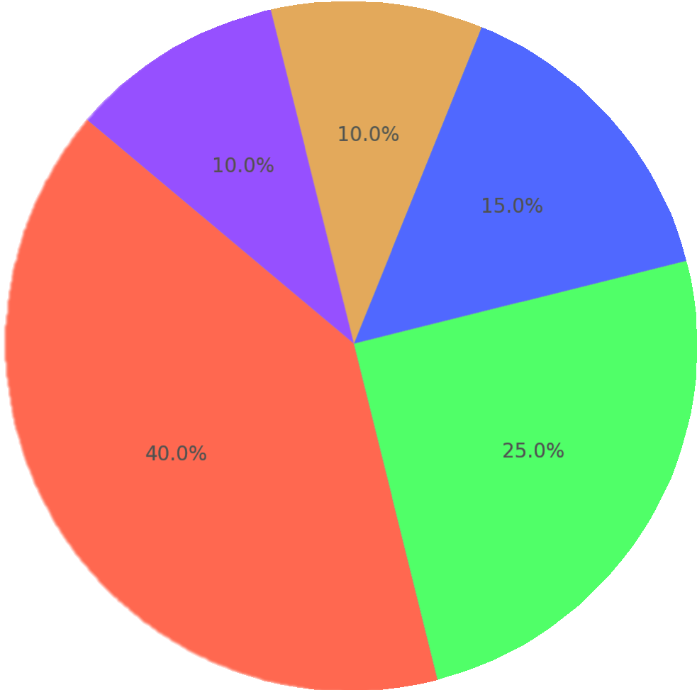


Impact and Benefits:
"2024 Smart Policing Using Facial Recognition - Implementation Areas"
Private security{malls, banks, stadium}
Traffic management & Public transportation
Public surveillance
& Smart cities
SOCIAL:
Improved Safety And Security
ENVIRONMENTAL:
Minimal Human Touchpoints
Easy Integration
There could be a fewer police patrols in high-risk areas, which would reduce humans deployed in those areas.
Law enforcement & Crime prevention
Border security & Immigration control
Ethical Considerations & Real-world Applications:
LIMITATIONS:
Accuracy is limited with low-light and occluded faces, Misidentification, in minority groups.
REAL-WORLD APPLICATION:
Real-world applications are boundless, with a few listed below:
Employee Attendance Management
Law Enforcement And Crime Prevention
Social Media Profile Verification
Hospital Management
Smart Retailing
Fintech Operations(financial)
PYEXPO 2025
IPS TECH COMMUNITY

Slide 7

Team Member Details:
Name
Roll No
Dept
Mourish Antony C
24UAD201
AI & DS - B
Harini M
24UIT120
IT
Natarajan V
24UAD205
AI & DS - B
Tejaashri K
24UAD254
AI & DS - B
Vinu Karthick D
24UAD262
AI & DS - B
PYEXPO 2025
IPS TECH COMMUNITY

Slide 8
THANK YOU !

